Slide 1
INF1009: Object Oriented Programming
Team Project Part 1
P8-Team 5
Chng Yu Qi Bernice (2302020), Yeong Chin Liong (2303296), Toh Jun Kuan Johnathan (2301915), OoI Jun Kai Jacob (2301828), Tan Sheng Le Brendan (2301782)

Slide 2
Contents
01
02
03
Scalability, Reusability & Design
Game Demo
All Game
Managers

Slide 3



Scalability, Reusability and Design
Scalability
Reusability
Design
The capacity of a game engine to expand and manage increased demands, allowing for more complex scenes, a greater number of entities, and advanced features without performance loss.
The ability to use game engine components across multiple games or scenarios, reducing the need for redundant code, saving time, and ensuring consistency and reliability in game development.
The strategic framework of a game engine, encompassing the arrangement of its parts for optimal performance, maintainability, and user experience, with the flexibility to adapt to future requirements.

Slide 4
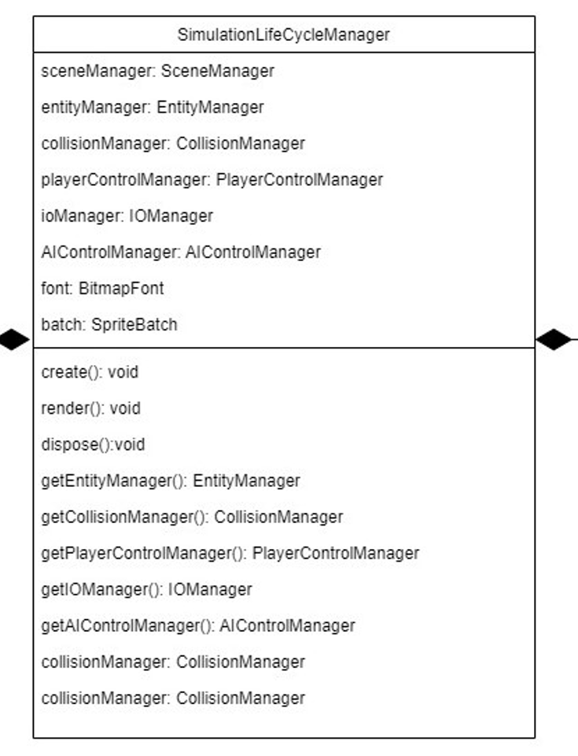
Simulation Lifecycle Manager
Initialises all Managers

Slide 5
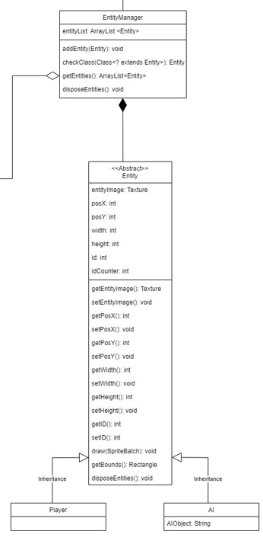
Entity
Manager
Handles the creation of entities and managing them
Notes:
The Entity Manager facilitates the addition and retrieval of entities, enhancing the game’s operational efficiency and maintainability. There are two different sub-classes for different kinds of entities within the game which allows for flexibility and functionality. It also forms an aggregation relationship because it is not a requirement for every scene that is created to have an entity.

Slide 6
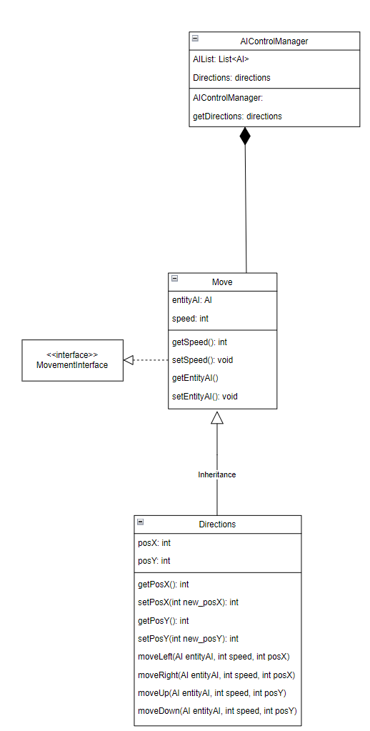
AI Control Manager
Handles automated movements for AI components in a list
Notes:
The AI Control Manager mainly handles the automated movements for AI entities in a list, providing a structured approach to accessing directional information from the class ‘Directions’. Implementation of the interface ‘MovementInterface’ dictates that all methods present in the class must be implemented.

Slide 7
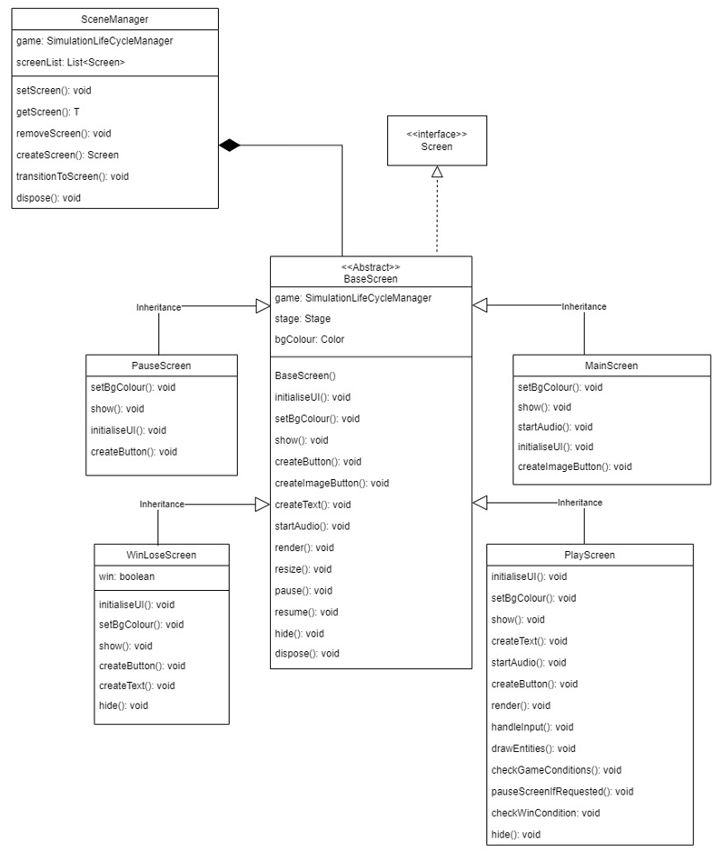
Scene Manager
Manages scenes by instantiating and changing screens when needed
Notes:
SceneManager works closely with is responsible of instantiating screens when needed, switching between screens, and keeping track of instantiated screens.
It does this by managing the screens inherited from the BaseScreen: MainScreen, PlayScreen, WinLoseScreen, and PauseScreen.
For example at the start of the game, MainScreen is instantiated is when the user clicks on “play”, the SceneManager will be in charge of transitioning the current screen to PlayScreen

Slide 8
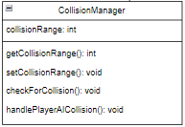
Collision Manager
Detects collision between entities
Notes:
Collision Manager is responsible for detecting collision between player and AI entities.
It does this by calculating the distance between the 2 entities, and checking if it is within the collision range.
For example in our game engine, when the player and entity collides, the collision manager will call the scene manager to transit to the WinLoseScreen.
If there is a collision, the program will then call SceneManager to transition to the WinLoseScreen.

Slide 9
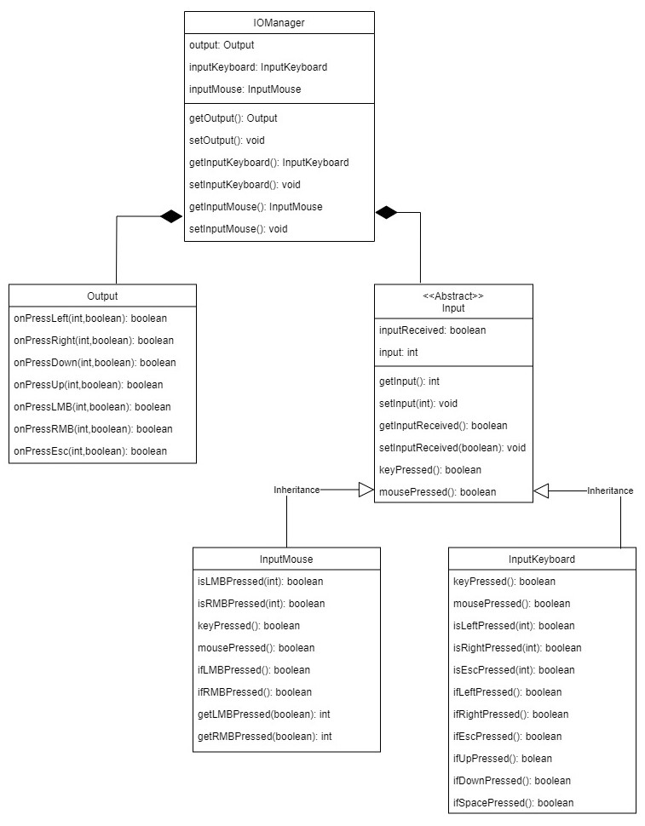
IO Manager
Handles different input and output operations from a keyboard and mouse
Notes:
IO manager handles different input types through InputKeyboard and InputMouse classes. This modularity allows for easy extension to include additional input methods in the future without altering the existing codebase.

Slide 10
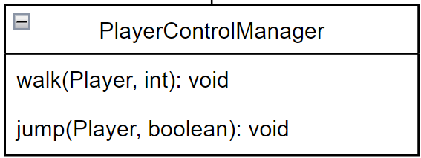
Player Control Manager
Focuses on translating user inputs into actions performed by player or entities
Notes:
The player control manager is responsible for translating processed inputs from the IOManager into actions and movements of the player. Walking is achieved by detecting right or left arrow key inputs to move the player horizontally, whereas jumping is controlled by a boolean flag that dictates vertical movement, simulating a jump or fall using up or down arrow keys.

Slide 11
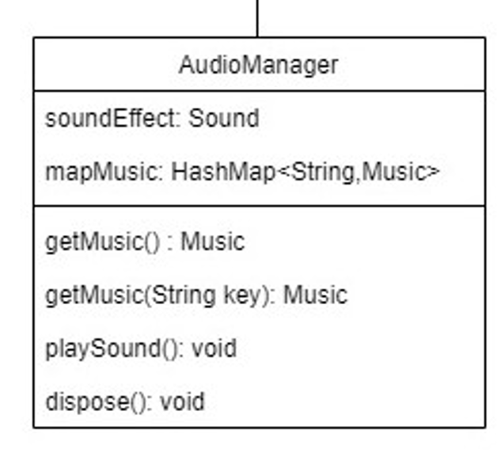
Audio Manager
Controls the music / sound effects that is playing

Slide 12
Game Demonstration

